Slide 1
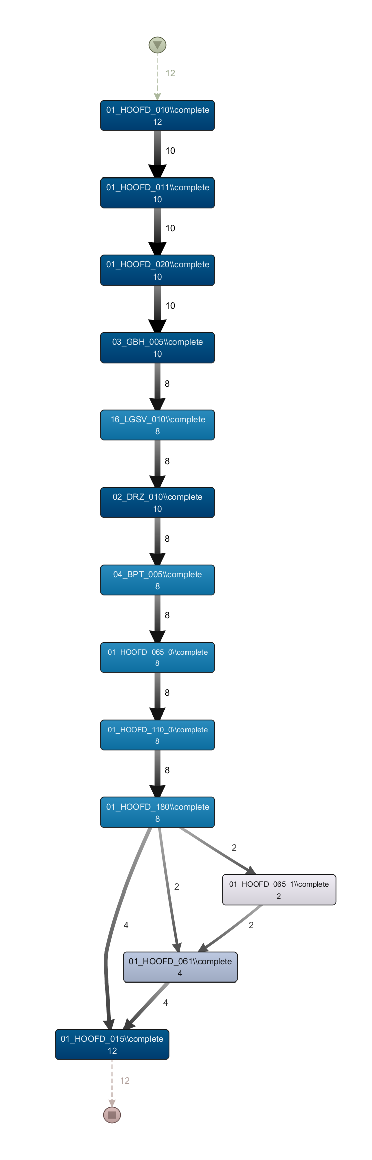
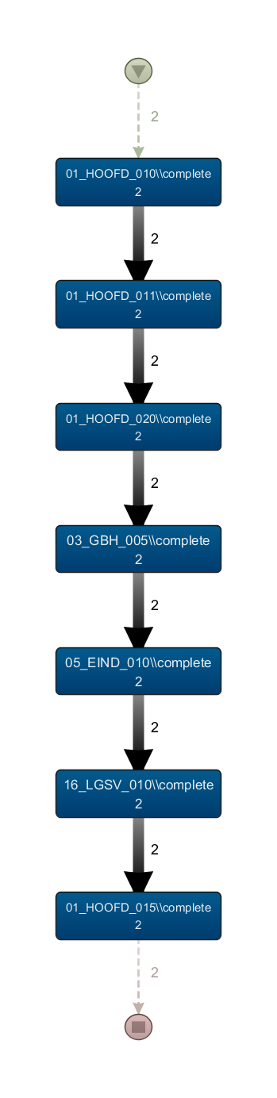
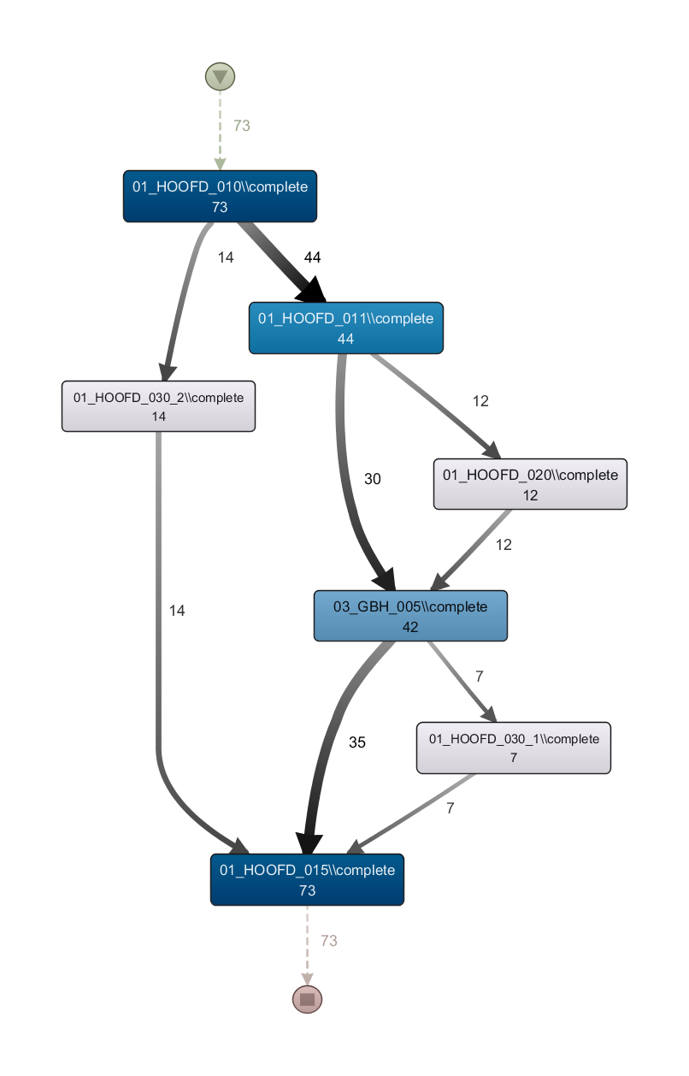
Different Moments in Processes
Different Dependencies
Municipality #2
(Cluster #3)
Municipality #3
(Cluster #1)
Municipality #4
(Cluster #3)

Slide 2
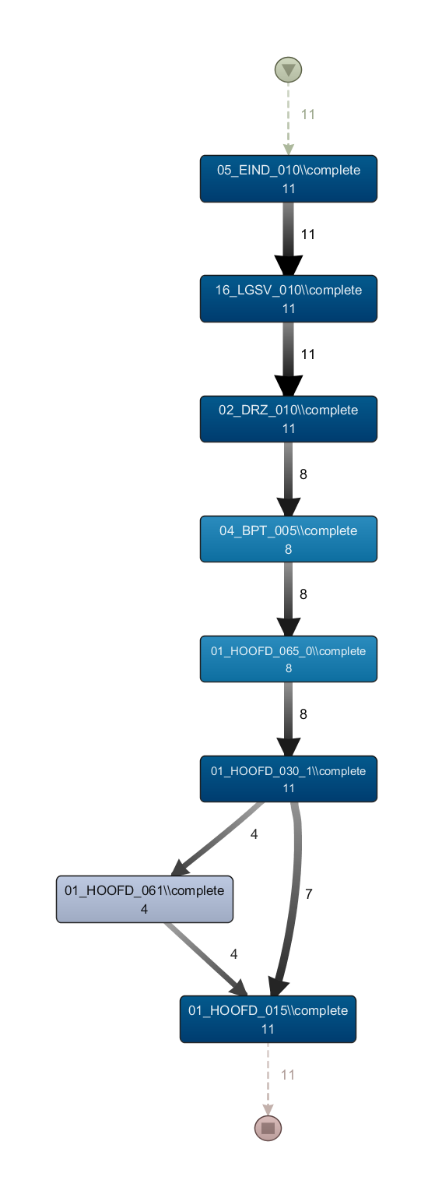
Different Moments in Processes
Different Dependencies
Municipality #2
(Cluster #3)
Municipality #5
(Cluster #1)
Municipality #4
(Cluster #3)

